Slide 1

CDVSA
Fiscal Administrative Processes
Britten Niemi, Administrative Operations Manager, (907) 465-1148
Anna Ramirez, Grants Administrator 3, (907) 465-2278
Chris Hardin, Grants Administrator 2, (907) 465-5496
Notes:
Presenters intro
Questions? Please write/submit your questions in the notecards and we will address them at the end of this presentation

Slide 2

Presentation Objective
To provide CDVSA Subgrantees a high-level overview on grant management and financial compliance processes.
Notes:
CDVSA works with subgrantees throughout the life cycle of a funded project to ensure their financial compliance with both award terms and conditions.
CDVSA grant administrators and program coordinators are here to help and are your resource for managing your awards.

Slide 3

Before we get started: Questions?
Fill out notecards with your question(s)
Email CDVSA.grants@alaska.gov your questions – “Subject: Sub-Grantee Meeting Questions”
CDVSA staff will compile all Q&A and compose an FAQ sheet. Will post on website and send via email.

Slide 4
Fiscal Administrative Processes
Presentation Outline
Budget Overview
Financial Reporting and Documentation
Grant Award Funds Distribution
Changes to your Approved Budget
Operational Assessment Tool/Monitoring Process
Grant Closeout
GrantVantage Future Enhancements
GrantVantage Trainings
Notes:
Budget Overview - Beginning of the year Budgets
Grant Award Funds Distribution – Advances and Reimbursements
Changes to your Approved Budget – Budget Adjustment Requests
Financial Reporting - Quarterly Financial Report
Grant Closeout
GrantVantage Future Enhancements
GrantVantage Trainings

Slide 5

Budget Overview
Detail the anticipated costs of the project you’re proposing;
Detail how your award will be spent.
Notes:
Your grant proposal must explain your request in both words (budget narrative) and numbers (projected costs detail). In other words, your grant budget must paint a financial picture
The “Grant Budget” is NOT your organizational budget.

Slide 6
Grant Budget Detail
Grant Budget Narrative
100 – Personnel
200 – Travel
300 – Facilities
400 – Commodities
500 – Equipment
600 – Other/Contracts
700 – Indirect Costs (DeMinimus)
Totals in Budget Detail($) = Totals in Budget Narrative.
Costs not properly supported in the narrative may require additional information and/or delay in execution of award.
Notes:
Categorize your costs in a way that makes sense – Your goal is to illustrate to the funder what it takes to successfully operate your program or complete your project.
As you’re thinking through all of this, try grouping items into broad categories like Salary/Wages, Travel, Equipment, Materials and Supplies, etc. Then, assign dollar amounts to these – being sure to provide descriptions of how you arrived at your dollar amounts.
Make sure costs tie in with your narratives – Someone should be able to look at your budget and understand what you’re proposing to do, even if they haven’t read your program or project description yet.
CDVSA has a Budget Guideline that provides examples on how to write your Budget Narrative.
Budget Overview is organized into “Budget Cost Categories.” Those budget cost categories are the following: (see slide)
These Budget Cost Categories may not match up with your own cost categories, but your financial system should be able categorize costs that fit into each one of these.
The Budget Narrative is where you’ll explain your sources of match (cash or in-kind)

Slide 7

Budget Guidelines
Budget guidelines are in the DOJ Financial Guide
under Chapters:
3.9 Allowable Costs
3.11 Indirect Costs
3.13 Unallowable Costs

Slide 8
Indirect Costs vs 10% De Minimis Rule
RULE: If you have a federally negotiated rate, you cannot use the 10% De Minimis rate. A copy of your current Federal Approved Indirect Cost Agreement must be provided at the time of award.
If you chose to use the 10% De Minimis rate you must apply it to all awards, even those not from CDVSA. For 2026, the De Minimis rate will increase to 15%.
For 2025 up to 10% (maximum) is allowed to be applied to a subaward. It can be lower.
You must first determine your Modified Total Direct Cost (MTDC) before you can find how much indirect you can use. A tool to assist you with determining your agency’s indirect can be found on our website using the link at CDVSA Indirect Calculator for Budgets
Notes:
The 10% de minimis rule is an optional indirect allowance that can be used by any organization who doesn’t have a federally negotiated indirect rate. If your organization has a federally negotiated rate, even if it’s expired, then your organization is prohibited from using the 10% de minimis rule.
10% is the maximum indirect rate under the de minimis rule. The indirect rate you use can be lower than 10%.
To calculate your de minimis indirect rate you must first determine your Modified Total Direct Cost (MTDC) for the funded program. Modified Total Direct Costs are
the program’s base cost that includes all direct salaries and wages, fringe benefits, materials and supplies, services, travel, and subawards and contracts up to the first $25,000. MTDC excludes the cost of equipment, capital expenditures, charges for patient care, rental costs, tuition remission, scholarships and fellowships. After you’ve determined your MTDC you may allocate up to 10% of that base cost. 2 CFR 200.
Some expenses will still need to be coded as direct cost. For instance, service providers, advocates, program managers and other staff who provide core functions to a program should not be paid using indirect. Administrative positions, human resources and other organizations support positions can be paid using indirect.

Slide 9
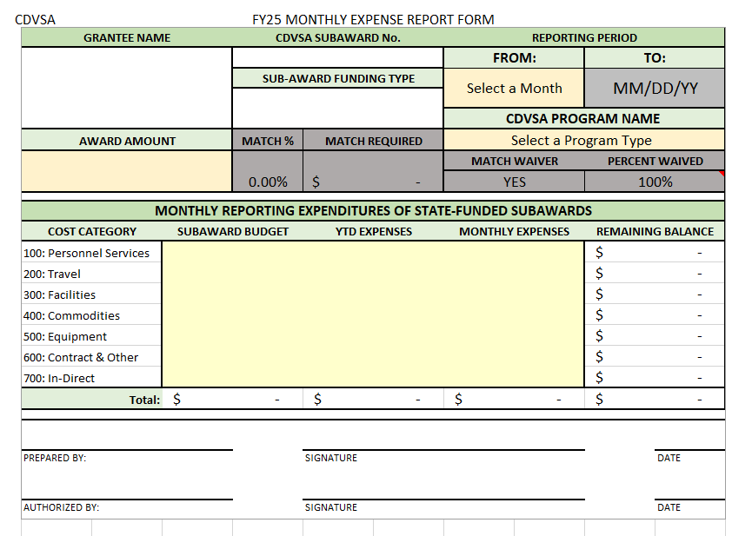
Financial Reporting and Documentation
All subgrantees will submit Monthly Expense Reports reflecting actual expenditures for the month and request Payments (Get reports in early and get paid!)
CDVSA Grants Administrators will review all Expense Reports and Payment Requests in GV
(First in, First out).

Slide 10

Drawdowns (Advances)
State General Funds
Grant Award Funds Distribution
State General Funds (GF) will be disbursed on a quarterly schedule in the form of a Drawdown.
Subgrantees will submit expense reports. GA’s will request/process quarterly Payments via Drawdowns (see Drawdown Schedule on next slide).

Slide 11
Advance One: By September 1st 25% of GF Award Amount *Date subject to change dependent on execution of grant award; automatically occurs. FY2026 50% of grant award will be paid no later than Sept. 15.
Quarterly Advance Two: September 15th 25% of GF Award Amount
Quarterly Advance Three: December 15th 25% of GF Award Amount
Quarterly Advance Four: March 15th 25% of GF Award Amount
Quarterly Drawdown Schedule
State Funds
Notes:
Subgrantees receiving State General Funds can request drawdown funds according to this schedule. The exception being the initial drawdown; this will be processed automatically by your grants administrator upon execution of your award. Please work with your grants administrator if you need additional funds outside of this schedule and final determination of drawdown amount will be based on cumulative financial reporting to date.

Slide 12

Monthly Reimbursements
Federal Funds
Federal grant funds will be disbursed through a monthly reimbursement process.
Subgrantees will submit expense reports. GA’s will request/process Monthly Reimbursement Payments.
Notes:
CDVSA is not allowed to advance federal dollars the same as state dollars;
Same as last year, CDVSA has created Reimbursement Request worksheets for all federally funded sub-awards. These worksheets basically create an invoice that is retained as a financial source document;
There are 12 scheduled monthly reimbursements per state fiscal year. The due date for a monthly reimbursement request is on the 15th of the following month;
The reimbursements are not expected to match your monthly reconciliation.
CDVSA requires a reimbursement request submitted every month. If there were no expenditures and no reimbursement is being requested, a zero-dollar reimbursement request still must be submitted;
If you weren’t able to include an expenditure in a previous reimbursement request, it may be applied to a future request.
Late reimbursement requests will not be processed until the 15th of the following month
Everything that is being requested for payment must be a reimbursement. We’ll be checking for this when we do Financial Desk Reviews; reimbursements requested prior to actual expenditure may be denied.
The anticipated payment dates for monthly reimbursements are found in the Reimbursement Request Worksheet.

Slide 13

Budget Change
Request Wizard (BAR)
When necessary to make changes to an approved budget, a Budget Change Request (BAR) is required prior to spending reallocated funds. DEADLINE 6/30/25
Subgrantee submits pre-approval to PC via email.
Once approved, subgrantee will submit their budget amendment to their Grants Admin/Program Coord.
Notes:
The BCR Wizard in GrantVantage is used to request certain budget allocation changes to an approved budget. This is initiated by the sub-grantee via email requesting pre-approval from your grants administrator/program coordinator
A BCR needs to be submitted whenever there’s a change to a budget cost category;
Your budget narrative should follow your budget categories (i.e. 100, 200, 300,)
100 – reduce by 1,000 and re-allocate to line 200
200 – increase by 2,000 to cover required all grantee meeting/training
300 – reduce by 1,000 and reallocate to line 200
The last day of the subaward performance period to submit a BCR is June 1st.

Slide 14
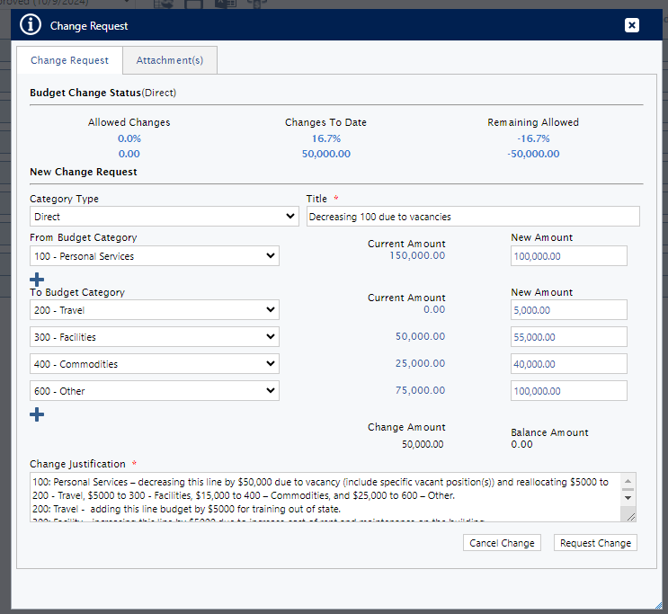
The Change Justification must provide detail why the reallocation of funds between line items in necessary. The narrative must include itemized costs within each cost category (see below):
100: Personal Services – $50,000 decrease due to vacancies (include specific position title(s) and dollar amounts); reallocating additional funds of $5000 to 200 Travel , $5000 to 300 Facilities, $15,000 to 400 Commodities, and $25,000 to 600 Other.
200: Travel - $5000 increase for out of state training (include number of trips, who traveling, where, when , why, rates, and estimated dollar amounts).
300: Facility - $5000 increase of rent and maintenance on the building (include dollar amounts).
400: Commodities - $15,000 increase for additional food cost for the shelter, program supplies, and household supplies (include dollar amounts).
600: Contractual/Other – $25,000 increase of insurance premiums, additional advertising, and increased registration fees and tuition (include dollar amounts).
The Budget Change Status (Direct) must address the total amount of the proposed change to each Budget Category 100 Personnel Services thru 700 Indirect Costs (see example above).
Notes:
Here’s an example of a budget change. The same format as original budget should be used for re-allocating across budget lines. A form should be used to get pre-approval for swapping out positions paid for by the grant.

Slide 15

De-obligation of Funds
As soon as a subgrantee knows they are unable to spend out their award, they should contact their CDVSA grant administrator to discuss the next step. De-obligation of funds will be performed by the CDVSA grant administrator. De-obligations are due by June 15th.
Notes:
CDVSA monitors the progress of each subaward to assure funds are being spent or drawn down consistently.
It is better to de-obligate funds as soon as you know you can’t spend the funds. Waiting until closeout to de-obligate funds is unacceptable (unless we’re looking at small amounts.) Subgrantees should know by 3rd quarter reporting if they’re unable to spend down their entire subaward.
The reason we need de-obligations completed by June 15th is that waiting until closeout to de-obligate creates the following problems:
CDVSA is unable to reallocate funds before a federal award expires;
CDVSA may not be able to reallocate funds in time for the next fiscal year;
State General Fund dollars do not carry over to the next fiscal year and underspending GF can create future CDVSA budget decrements;
CDVSA is required to collect unspent advanced funds.
A request to de-obligate funds should be submitted to CDVSA.grants@alaska.gov prior to June 1
CDVSA will prepare an amended subaward agreement showing the reduction of funds. This amended subaward agreement will be signed by your agency’s authorized approver and the CDVSA director. A fully signed copy will be emailed to you for your records.

Slide 16

Grant Closeout
Prepare for closeout three months prior to the end date of the grant cycle. Allows for accurate forecasted expenses and prepare adjusting journal entries to reflect actual costs to the grant.
The purpose of the closeout:
Ensure grant funds were spent appropriately.
Record timeliness of reports.
Avoid refunds to the State.
Ensure final reported expenditures do not exceed the total award (CDVSA allows a 10% variance per cost category).
Notes:
The final report is due July 30. The final reimbursement will occur by August 15th.

Slide 17

FINANCIAL COMPLIANCE MONITORING

Slide 18
Financial Monitoring & Compliance Process
Conduct Operational
Assessment Tool (OAT)
Determine OAT Level
Develop Monitoring Schedule for all sub-grantees
Request Supporting Documentation for Review (FDR)
Review Documentation for compliance (FDR)
Follow-up Discussion with Sub-grantee

Slide 19

Purpose of Financial Monitoring
Ensures subgrantee’s accounting system, policies and procedures and financial records are adequate to administer federal and state funds;
Ensure subgrantees have internal controls in place to safeguard against fraud, waste and abuse;
Assess compliance with program, federal and state guidelines;
Provide technical assistance;
Make recommendations for improvement/give kudos too!

Slide 20
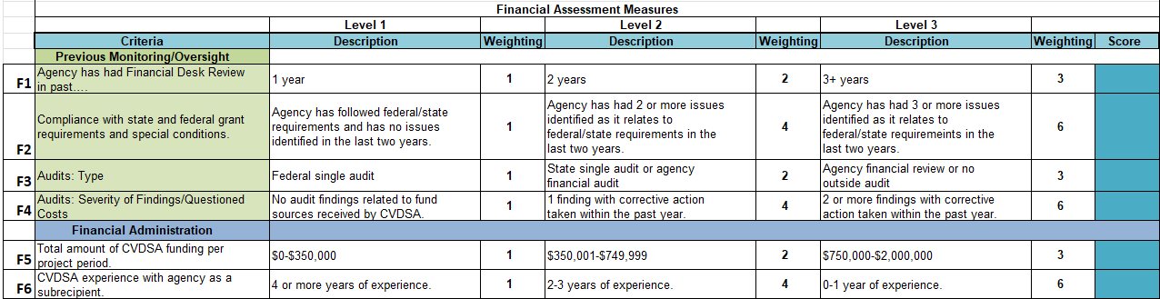
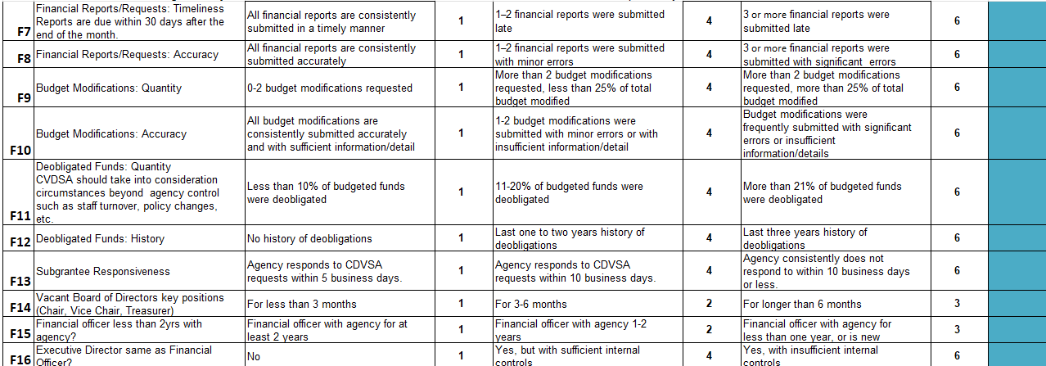
Operational Assessment Tool (OAT)

Slide 21
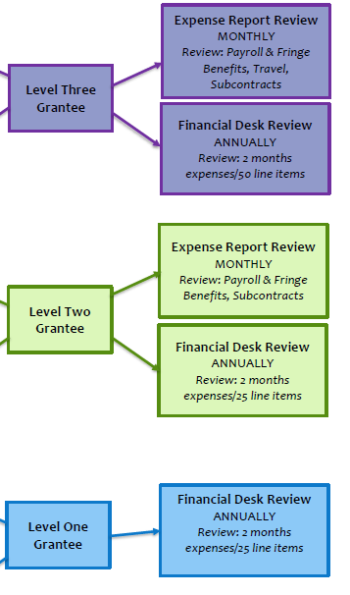
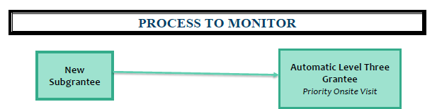
Operational Assessment - Levels
Assessment
level =
Monitoring
level

Slide 22
Operational Assessment – Financial Desk Review (FDR) Process
CDVSA Develops Monitoring Schedule for Financial Desk Reviews
  Subgrantee will work with CDVSA grants administrator to coordinate documentation submission per their OAT level
Prepare for the Review – Entrance Meeting with GA/Subgrantees
  GA will determine which period to request for review based on assessment level
  Develop a checklist of supporting documents to review from the sub-grantee
  Review all financial materials sent by sub-grantee. Follow up if materials are missing or questions
GA will Conduct the Financial Desk Review
FDR Exit Meeting with subgrantee to review the results/timeline for corrections

Slide 23
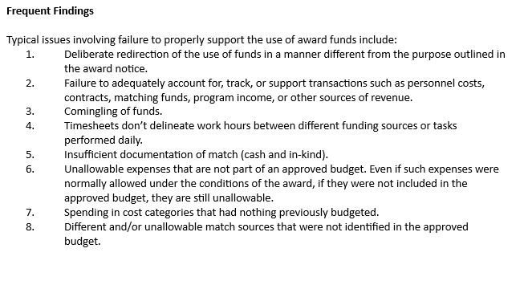
FREQUENT FINDINGS

Slide 24
Future GV Enhancements
Coming soon:
Budget Change Request Wizard (aka BAR)Process
Financial Desk Reviews(FDR) will be tracked in GV.
Subgrantee requests Drawdowns and/or Reimbursements to correctly follow the workflow of the grant process.

Slide 25
Upcoming GV Webinars
Coming soon:
Starting in November 2024: CDVSA Grants Administrators will be setting up mandatory Webinars to train grantees how to use the Learning Management System for all grant management processes – specifically Budget Change Request process.
Expect a required GV Webinar training to be held on a quarterly basis.

