Slide 1

CDVSA Data
Present, Transitions, & Future
Research Analyst 3
Catherine Mohn
2024 Meeting

Slide 2
Federal Grants
The why behind the requirements

Slide 3
VOCA
Reporting period: State fiscal year 7/1-6/30
Only VOCA funded services and clients
Enhanced Services follow these requirements if they don’t receive OVC-DISC

Slide 4
FVPSA Core (Regular Fvpsa)
Reporting period: 10/1-9/31
All funding sources
Only domestic violence related clients

Slide 5
FVPSA ARPA
Reporting period: 10/1-9/31
Only Fvpsa Arpa funding source
Both domestic violence and sexual assault related clients

Slide 6
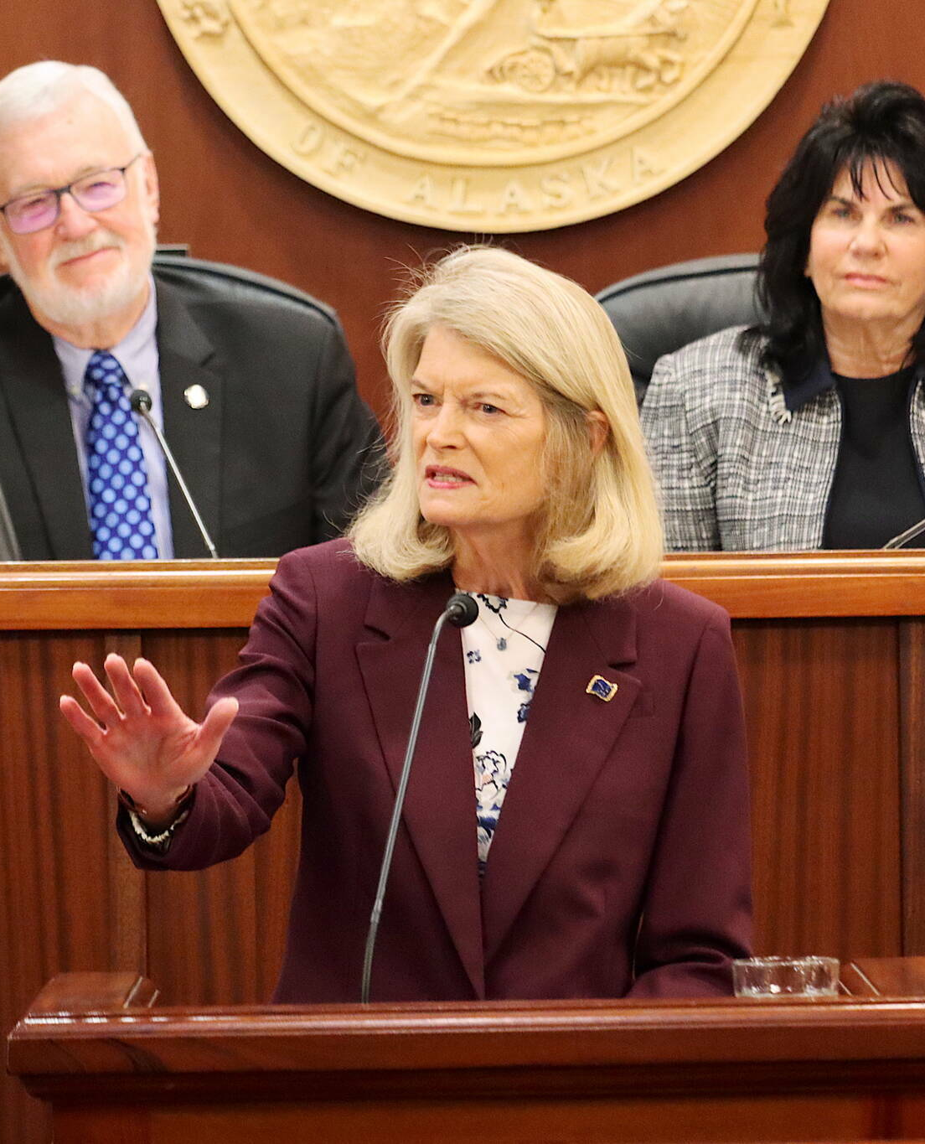
OVC-DISC (Transforming Victim Services Grant)
Domestic violence providers need more money .
(Thanks Lisa!)
Reporting period: State fiscal year 7/1-6/30
Relief funds – broad reporting requirements
Earlier federal due date than other grants
Only OVC-Disc funded services and clients

Slide 7
State Fiscal Year 2024

Slide 8
Victim Services
Total Served : 7,331
Notes:
Large unknown category due to Access errors

Slide 9
Victim Services
Total Services: 361,614
Family Violence / Domestic Violence
5,955
Adult Sexual Assault
1,026
Adult Physical Assault
952
Stalking / Harassment
495
Top Victimizations
Top Services | Count
Individual Advocacy | 102,637
Benight | 73,697
Support Group | 50,763
Individual Counseling | 29,353
Emergency Financial | 20,317
Hotline Counseling | 18,323
Crisis Intervention | 17,131

Slide 10
Enhanced Service: Child Advocacy Centers
Total Served :1,605

Slide 11
Enhanced Service: Child Advocacy Centers
Child Sexual Abuse
926
Child Physical abuse / Neglect
471
Domestic / Family Violence
131
Bullying
62
Top Victimizations
Total Services: 8,776
Top Services | Count
Individual counseling | 1,085
Forensic exam or interview, or medical evidence collection | 918
Individual advocacy | 860
Crisis Intervention | 637
Victim rights information | 627
Criminal justice information | 611

Slide 12
Enhanced Service: Legal Assistance
Total Served :581

Slide 13
Enhanced Service: Legal Assistance
Domestic / Family Violence
926
Bullying
235
Adult Sexual Assault
225
Adult Physical Assault
170
Top Victimizations
Total Services: 9490
Top Services | Count
Civil legal assistance - family law | 3,256
Immigration assistance | 1,436
Immigration assistance | 1,436
Civil legal assistance - protection order | 866
Individual advocacy | 687

Slide 14
Enhanced Service: Mental Health
Total Served :178

Slide 15
Enhanced Service: Mental Health
Domestic / Family Violence
127
Bullying
99
Child Physical abuse / Neglect
99
Child Sexual Abuse
57
Top Victimizations
Total Services: 543
Services | Count
Individual counseling | 440
Individual advocacy | 54
Other therapy | 28
Support groups | 11
Crisis Intervention | 10

Slide 16

Transitions
&
Updates

Slide 17

Vela
Notes:
Add other states that have launched: waiting on updated list from Marie
Huge transition this year
Unlimited TA, please use it
When using the system if you have ideas, please let us know
Thank ANDVSA for their partnership on this project
Make this on the shorter side as they have been through a lot of training on the topic

Slide 18
Data = Credit
“Data enables us to assess the situation related to violence against women in any given country. It reveals to policymakers and state and non-state actors the gravity of the problem and provides comprehensive information on the prevalence, causes and consequences of all types of violence against women. It is essential for developing effective legislation, creating strategies and protocols for the implementation of legislation, and advocating for where and how to target funding and support. Data also informs policymaking and the development of tools to prevent violence against women and protect potential victims.”
Lirie Dina JD.
Civil Legal Initiatives – UN Women's program funded by the European Union
Notes:
- I know you all do incredible work. We need to show legislature and funders
- Data is how we can strengthen our argument for more funding in the future

Slide 19
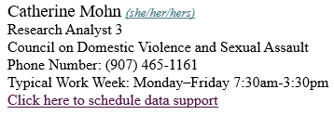
Please always reach out
Work Phone: (907)465-1161
Email: Catherine.Mohn@alaska.gov
Calendly
Notes:
Times I get to work with our advocates = favorite part of the job
Express gratitude: It truly is an honor to get to work in this state with you all doing important work

Slide 20
Questions
Notes:
- Save 15 minutes for questions

